Slide 1
Circuits & Mechanisms Governing Serotonergic Psychedelics BehavioralEffects
Kevin Krupp

Slide 2
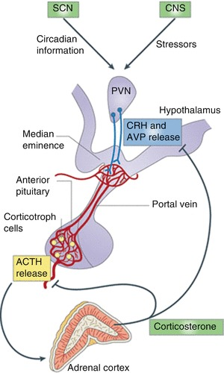
Stress
Adaptive
HPA axis activation & stress hormones
Chronic stress → Depression
Symptoms – Anhedonia, Despair, Suicide
Inadequate Treatments – 1 in 3 find relief
But…

Slide 3
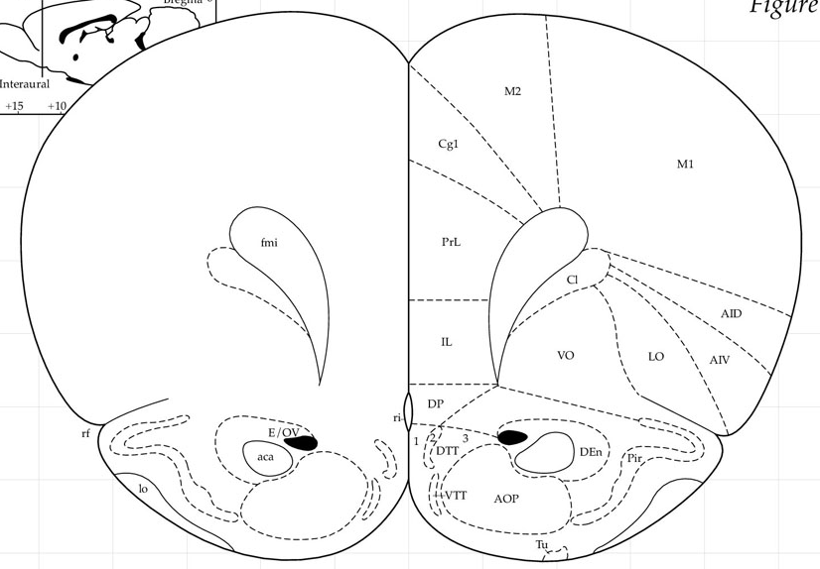
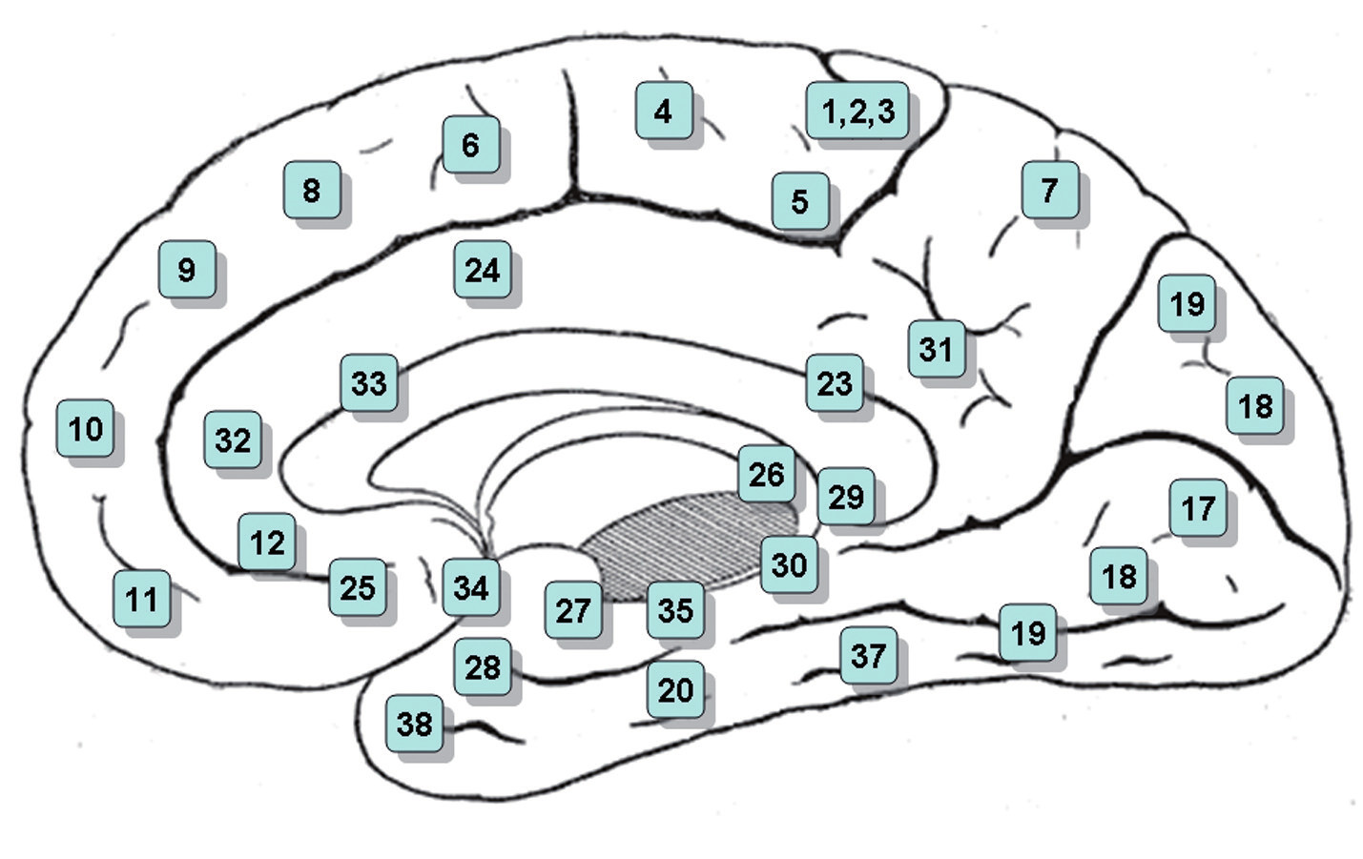
I
II /III
IV
V
VI
PrL
IL
Glu
Glu
Executive decision-making region
Regulates stress responses
Connections to the basolateral amygdala (BLA) to promote pro-stress or anti-stress behavior
IL
PrL
To BLA

Slide 4
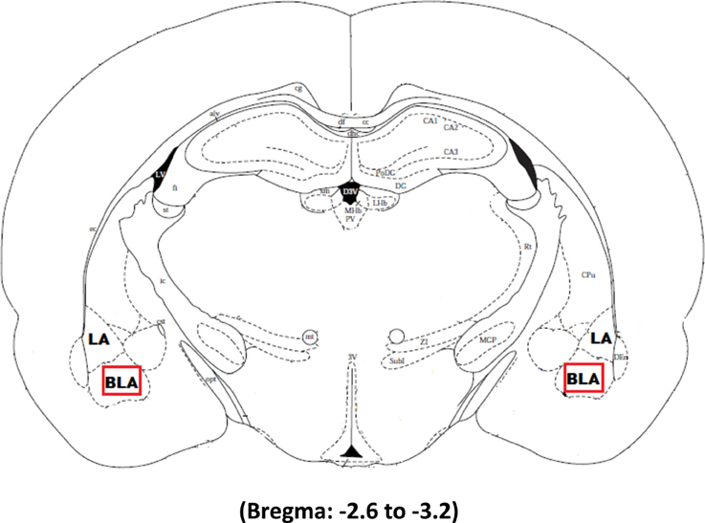
Basolateral Amygdala
From mPFC
Gates expression of emotional behaviors
Cellular changes resulting from emotional learning
Reciprocal connections with IL/PrL
LA
BLA
Glu
Glu

Slide 5
Paraventricular nucleus of the Thalamus
Anterior – Type II Neurons (Galanin expressing, D2⁻)
express Galanin, but not D2-receptor
Selectively target the Mid + Superficial layers of the Infralimbic Cortex (non D2)
Receive most input from the Infralimbic cortex
Innervate the medial intercalated cells (Fear off)
inhibited by salient stimuli and differentially modulated by arousal
Posterior – Type I Neurons (D2⁺) *Aversive?*
Gradient across anterior-posterior axis
more in the posterior
Dense expression of D2 compared to Anterior Type I Neurons, don’t express Galanin
Selectively innervate the Prelimbic Cortex (Target Deep layers) (D2 receptor expressing)
Preferentially innervated by the Prelimbic Cortex
Heavily innervate the CeA (Fear on)
These regions do not communicate w/ eachother
Independent Thalamo-cortical loops
“Two genetically, anatomically and functionally distinct cell types segregate across anteroposterior axis of paraventricular thalamus”

Slide 6
Basolateral Amygdala
+ mPFC
LA
Glu
Glu
IL
PrL
BLA
Anti-stress
Behavior
Glu
Anxious
+
Depressive
Behavior
aPVT
pPVT
Glu

Slide 8
Psychedelics & Depression
Single dose
Up to 6 months
Animal models: Prefrontal Cortex & Amygdala involved
Circuits & mechanisms still unknown
How do environmental differences change long-term outcomes?
LSD
DMT
Psilocybin
Rapidly reduce symptoms of depression

Slide 9
(R)-DOI
Don’t activate 5-HT_{1A} like other psychedelics shown to be antidepressive, but therapeutic potential not known
Still psychedelic via 5-HT_{2A} binding
(-) DOI *more behaviorally potent*
2-3 times in drug discrimination/generalization
2x more potent at produce Head Twitch Response (HTR) in rodents
2x more active in humans
↑ Glutamate & Dopamine release in PFC
(R)-DOI
How does (R)-DOI impact mPFC???

Slide 10
Serotonergic Psychedelics and 5-HT_{2A} signaling
(Gewirtz et al. 2002)
DOI (5mg/kg)
↑ BDNF mRNA in mPFC
mGlu₂ agonist (LY35470)
dose dependently blocked upregulated BDNF in mPFC, other cortical regions, claustrum
But not midline/intralaminar thalamus
LY341495 (mGlu₂ antagonist)
enhances DOI induced BDNF upregulation in the mPFC
Plasticity in mPFC from DOI also depends on 5-HT_{2A}, BDNF & mTOR
BDNF in mPFC blocked by AMPA/NMDA antagonists

Slide 11
DOI induced Arc expression blocked by 5-HT_{2A}, AMPA, and NMDA antagonists
Arc expression largely overlaps w/ c-fos expression (parietal cortex)
some 5-HT_{2A}⁺, some without
In Cingulate cortex, arc is increased in NMDA+ cells
Pei et al. 2000
Pei et al. 2004

Slide 12
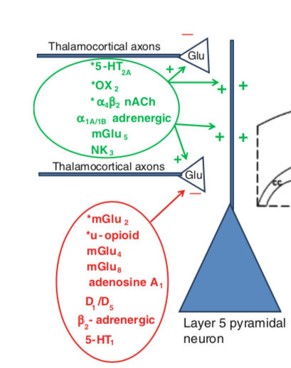
(Price et al. 2019)
Sprague dawley rats
ACC
PrL
IL

Slide 13
5-HT_{2A}
Generally/classically thought of as a post-synaptic receptor
mGlu₂
Generally/classically thought of as a pre-synaptic receptor

Slide 14
Electrophysiology in Prelimbic Cortex (PrL) using brain slices
Sustained stimulation of 5-HT_{2A} receptors (20 min. w/ DOI)
↓ AMPA transmission at layer I-V
synapses of PrL
- NMDA-receptor independent
Dependent on activation of 5-HT_{2A}

Slide 15
Electrophysiology in Prelimbic Cortex (PrL) using brain slices
Postsynaptic 5-HT_{2A} on pyramidal neurons in the PrL/ACC mediate effect

Slide 16
DOI (20 min) prevents
electric pairing induced
LTD
Electrical pairing protocol
-7 trains of 50 Hz stimuli (100 pulses per train)
- Delivered at 0.1 Hz
- Induces LTD at layer I/V mPFC synapses.
Effect blocked in 5-HT_{2A} KO mice

Slide 17
Postsynaptic 5-HT_{2A}
5-HT_{2A} → +PKC → pGluA2 → endocytosis
DOI (20 min) prevents LTD
from electric pairing
Electrical pairing protocol
-7 trains of 50 Hz stimuli (100 pulses per train)
- Delivered at 0.1 Hz
- Induces LTD at layer I/V mPFC synapses.
Effect dependent on
postsynaptic 5-HT_{2A} in PrL/ACC

Slide 18
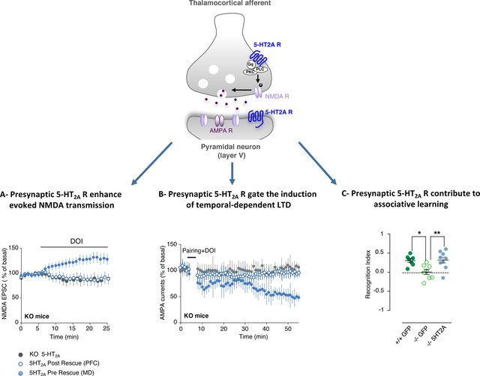
Presynaptic 5-HT_{2A}
Bećamel et al 2017

Slide 19
DOI may reverse BDNF deficits in depression
Depend on Glutamate release & action on NMDA + AMPA
Promotes Arc expression to promote plasticity as well
Postsynaptic 5-HT_{2A}
Promotes AMPA internalization
Long-term depression
Presynaptic 5-HT_{2A}
Promote t-LTD at synapses via NMDA receptor activation
Critical for associate learning

Slide 20
(R)-DOI induces phospho-cFos expression in small subset of cells
More cells w/ higher c-fos levels stabilized in the nucleus - more cells actively undergoing transcription ?

Slide 21
DOI Fos(+) neurons higher c-fos than DOI Fos(-)
- but control Fos(+) not different than control Fos(-)
- i.e. DOI Fos(+) have more fos compared to
DOI fos+ express higher FosB compared to control fos+
Fos(+) = neurons gated as highest 2.5% of phospho-cFos IR neurons
Fos(−) = neurons as lowest 80% of phospho-cFos IR neurons

Slide 22
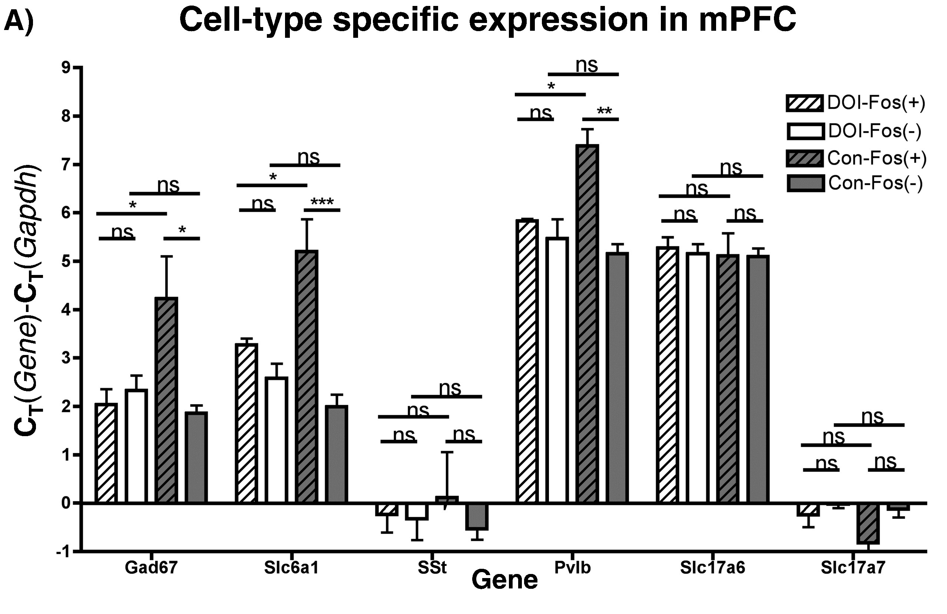
few interneurons produce phospho-cFos under baseline conditions
GABA
Interneuron
Solute Carrier Family 17
Member 6
GAT-1
Somatostatin
Parvalbumin
VGLUT1
DOI increase # of fos+ interneurons in mPFC, specifically PV neurons

Slide 23
i). DOI-fos(+) have high 5-HT_{2A} mRNA compared to Con-Fos(+)
- directly activation by DOI
ii). DOI-fos(+) have higher mGlu2 mRNA, but also in controls

Slide 24
DOI increase PV neuron activation in mPFC
In control conditions, very little PV w/ c-fos
No correlation w/ PV & 5-HT_{2A} expression
not all directly activated by DOI, Claustrum?

Slide 25
(R)-DOI (6.0 mg/kg) systemically → ↑ Internalization of 5-HT_{2A} in deep
layers of the Prelimbic Cortex
+ Orbital Cortex / Agranular Insular Cortex/Claustrum
Many neurons that internalize 5-HT_{2A} do not express c-fos & vice versa
→ internalization doesn’t activate neurons, may come from NMDA activate from Glu spillover / D1 + DA

Slide 26
Deep layers of PFC

Slide 27
[DOI] in whole blood and forebrain over time
Ultra high-performance liquid chromatograph tandem mass spectrometer (UHPLC-MS/MS)
[DOI] greater in forebrain than in whole blood
- Suggests there’s an accumulation of DOI in the brain, due to internalization?

Slide 28
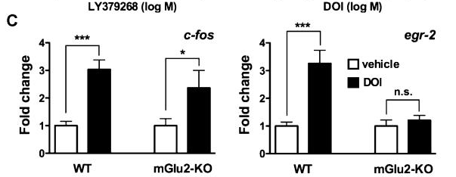
Frontal Cortex of C57/Blk6 mice treated w/ DOI
mGlu2 KO dampens c-fos
mGlu2 KO completely blocks egr-2
expression
C-fos still increased in mGlu2 KO mice
Trigger population?
Moreno 2011

Slide 29
DOI activates a “trigger population” of excitatory neurons in the mPFC
Leads to psychedelic effects
DOI transcriptionally activates PV interneurons in the mPFC, mostly through an indirect mechanisms
What about Head twitch?

Slide 30
Time-course of DOI-induced HTR
Mice habituated to coil for 30 min. then injected w/ DOI (1 mg/kg) or vehicle (i.p.)

Slide 31
DOI disposition similar to rate of HTR decay
But half-life of DOI in forebrain is 36% longer (∼24 min) than that of HTR decay
Due to muscle fatigue?

Slide 32
muscle fatigue?
Used isoflurane anesthesia to block all motor activity for first 30 min after of DOI (1 mg/kg) administration
- The control group was held in the home cage for the 30 min
Notes:
other groups have reported that jerks and twitches may be still observable in DOI (∼4 mg/kg)-treated mice under isoflurane anesthesia³¹.
no motor activity was evident, other than respiratory function, in DOI (1 mg/kg)-treated isoflurane-anesthetized mice.

Slide 33
↑ time course of
DOI induced HTR
↑ total # of HTRs
DOI
Coadministration of mGlu_{2/3} antagonist (LY341) and DOI
No effect on HTR when administered alone
Habituated to coil for 15 min
- Administered LY341 (3 mg/kg) / vehicle
- After 30 min, administered DOI (0.5 mg/kg)

Slide 34
Coadministration of an mGlu₂ agonist (LY404) and DOI → ↓ HTR frequency
DOI
Habituated to coil for 15 min
- Administered LY404(5 or 10 mg/kg) or vehicle
- After 5 min administered DOI (1 mg/kg)

Slide 35
Coadministration of an mGlu₂ agonist (LY404) and DOI → ↓ HTR frequency
LY404 dose-dependently ↓ HTR for first 30 min
LY404 dose-dependently ↑ HTR from 60-90 min

Slide 36
Accumulation of DOI in mPFC due to 5-HT_{2A} internalization?
Glutamate release in mPFC important for c-fos, egr2, head twitch response, BDNF & arc expression
Trigger population directly activated by DOI
Sets up window of plasticity
How environment influences effects ?
Promoting plasticity based on experiences via glu release from different sources ?
Positive experiences selectively induce plasticity via aPVT (IL)
Negative experiences induce plasticity via glu release from pPVT (PrL)
Postsynaptic 5-HT_{2A} may promote LTD in the PrL
Decrease Negative Affect?
May be part of therapeutic efficacy of DOI
Higher 5-HT_{2A} expression in PrL compared to IL
Similar to fluoxetine

